Slide 1


Astrosage
Analysis
Improving Efficiency and Customer Satisfaction
By : Vishal Ratnakar
Date : 30/08/2025

Slide 2


OBJECTIVE
AstroSage has received a 1 crore investment and aims to optimize its call center operations. The goal is to determine how to allocate this investment to maximize operational efficiency, customer satisfaction, and profitability. The analysis will consider historical call data, performance metrics, and market trends to make informed decisions.
The primary objective of this analysis is to optimize call center operations, enhance agent performance, and elevate overall customer satisfaction.

Slide 3
What is Astrosage
AstroSage is a comprehensive astrology platform that connects users with astrologers and spiritual advisors for personalized guidance. As a digital call center, AstroSage provides services through various channels, including calls, chats and allowing users to receive insights about their future, relationship advice, career guidance, and spiritual support. By leveraging a team of experienced astrologers, known as "gurus" AstroSage enables users to ask questions and gain clarity on life decisions, aligning with the ancient practices of astrology while utilizing modern technology to make these services accessible and convenient.
AstroSage's platform also supports features like free calls, chat consultations, and even region-specific guidance, creating a holistic experience for users from diverse backgrounds. This call center service strives to deliver high-quality, personalized experiences, ensuring that users find meaningful, insightful support to address their individual needs.

Slide 4

Astrosage Data overview
Dataset:
Key Performance Indicators (KPIs)
Total Sessions: 28,027
Total Users: 10,344
Total Revenue: 214,066
Total Calls: 8511
Total chats:19514
Active Gurus: 131

Slide 5
Data Cleaning and Preprocessing
Created new columns by applying unique function on guru name ,user_id,g_id to fetch total no of gurus ,Active Guru and total users
Applied Text to columns on date columns to filter dates and time separately
Created a new column named Rating Bucket by applying conditional function on Rating column to categorize rating into High,good or bad
Addressed missing values in guru name data field to enhance data integrity.
Utilized functions like TRIM, CLEAN, and Remove Duplicates to ensure data accuracy.

Slide 6
Overview of call Analysis
Total no of users who made calls : 3628
One Time Callers : 2353 (These users only made one call)
Repeat Callers : 1275
Total Calls by Repeat Users: 6,012 calls
Percentage of repeat callers excluding initial calls : 56.6%

Slide 7
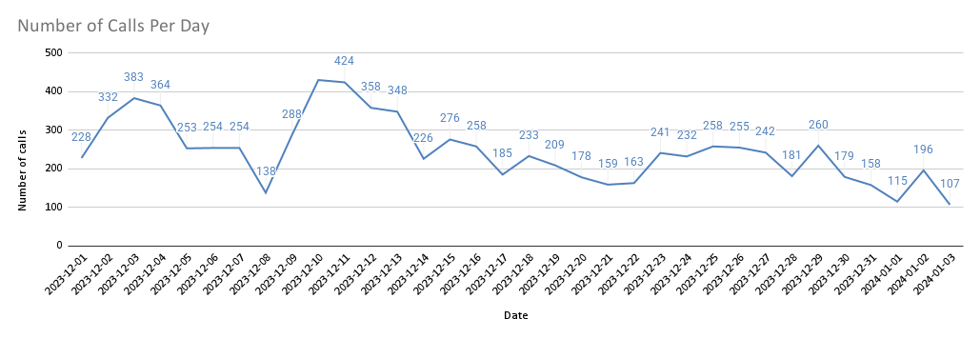
Daily Call Analysis
Key Insights :
1.91 calls are handled per agent per day
Decreasing call volume is noticed day by day
Recommendations :
Need to improve by adding some offers or providing some complimentary calls to gain customer satisfaction

Slide 8
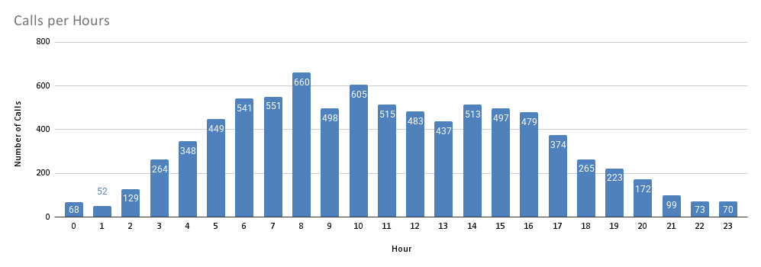
Calls per hour
Key Insights :
The call volume peaks between 6 AM and 11 AM, with the highest number of calls at 660 during 8 AM.
Allocate more agents during peak hours, especially from 7 AM to 11 AM, to ensure adequate support and reduce wait times.

Slide 9
Peak hours Traffic
The highest demand times appear to be in the early morning (6-11 AM) and late afternoon to early evening (4-6 PM) based on average durations.
Peak periods are often identified by hours with the highest average on-call durations, such as 7 AM and 4 PM in dataset.

Slide 10
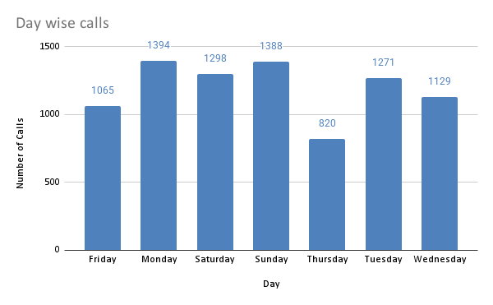
Day wise call volume
Key Insights
Higher call volumes on Sunday, Monday, and Saturday
To address this trend that call centers should staff more agents on these days to handle demand efficiently.

Slide 11
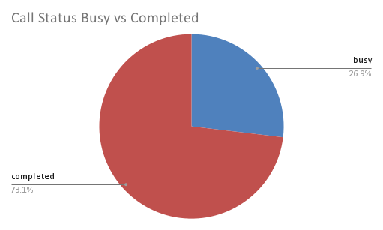
Call Status completed vs busy
Key Insights:
Nearly one-fourth of calls result in a busy status, which could indicate peak traffic periods, insufficient staffing, or limitations in infrastructure.
Recommendations :
Expanding call-handling capacity during peak hours.

Slide 12
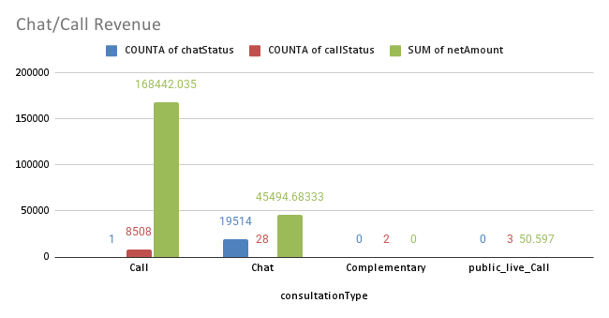
Chat And Call Revenue
Insights
Higher Calls Revenue as compared to chat revenue
Higher number of chat activity is noticed as compared to calls

Slide 13
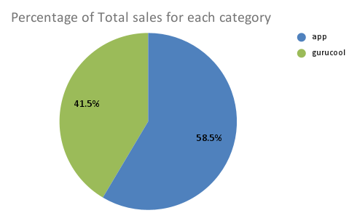
Percentage of total sales
Key Insights :
App Sales Dominate: With 59% of total sales, the app is the leading channel.
Gurucool's Contribution: Gurucool accounts for 41% of sales, a significant share.
Recommendations :
Consider customer feedback and performance metrics to identify why the app leads in sales and replicate similar strategies for Gurucool.

Slide 14
Category wise Guru Earnings
Key Insights :
Higher Earnings on the App Platform as compared to gurucool in calls is seen

Slide 15
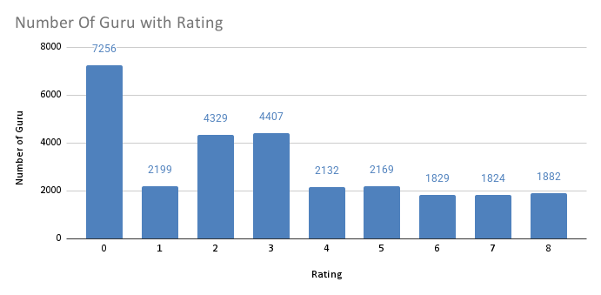
Rating of Gurus
Key Insights:
Most gurus fall within the 2 to 4 rating range, with a notable peak at rating 3 (4,407 gurus).
There are fewer gurus in the higher rating categories (5 to 8), which signals an opportunity for improvement. Only a small portion of gurus have reached top ratings.

Slide 16
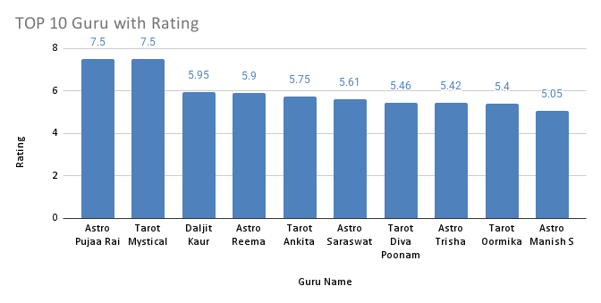
Top 10 High Performing Gurus
Recommendations:
Focus on training programs on lower rated gurus to gain customer satisfaction

Slide 17
Approach
Created a pivot table on guru names in x axis and ratings on y axis used filter in pivot tables on rating bucket applied filter on high ratings
Insights
Astro Krishaa has achieved the highest number of ratings, (with a rating exceeding 6). This demonstrates a strong level of customer satisfaction and positive feedback compared to other gurus in the field.

Slide 18
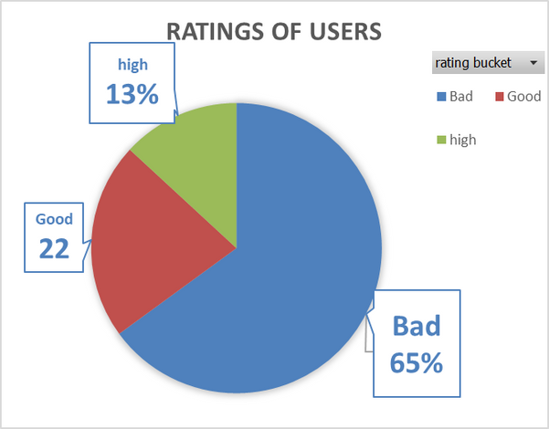
Ratings Percentage of users
Row Labels | Count of uid
Bad | 17204
Good | 5809
high | 3475
Key Insights:
Majority of users are dissatisfied, indicating issues with service quality or customer support.
A small portion of highly satisfied users; analyze what drives their satisfaction and replicate it.

Slide 19
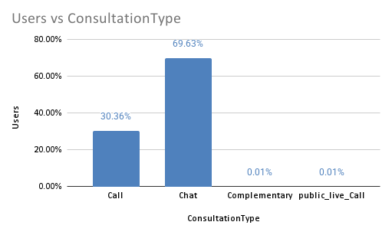
Consultation vs users
Key Insights:
Chat consultations dominate, making up 69.63% of the consultations, indicating that users prefer using chat for their consultations.
Call consultations contribute 30.36%, showing that a significant portion still values voice communication.
Complementary consultations and Public Live Calls are almost negligible, with only 0.01% each.

Slide 20
ANALYSIS DASHBOARD

Slide 21
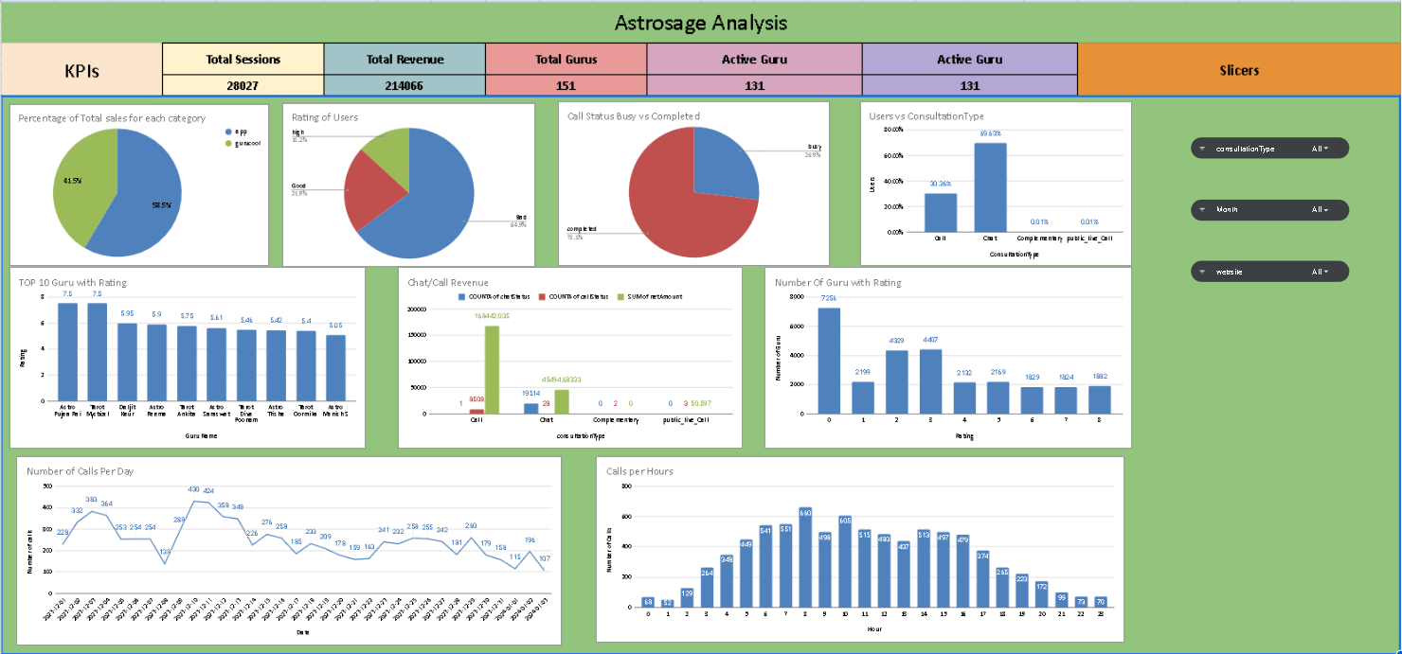

Slide 22
Overall Recommendations
Focus on Peak Period Management
Insight: The analysis showed distinct peak call hours, particularly during the morning and late evening.
Recommendation: Allocate a portion of the investment towards increasing agent availability during peak hours, either by hiring additional part-time agents or by incentivizing flexible shifts among current agents. This will help reduce wait times, increase answered call rates, and enhance customer satisfaction.
Prioritize Support for Repeat Callers
Insight: Repeat callers accounted for around 71.9% of total calls, indicating high user engagement but also potential follow-up needs.
Recommendation: Develop targeted strategies for repeat callers, such as offering proactive customer service or exclusive loyalty programs. This could include dedicated support for high-frequency users, improving their experience and potentially increasing revenue through value-added services.
Optimize User Experience on Call and Chat Platforms Insight: High-quality service across platforms is essential for diverse user engagement. Recommendation: Use chatbots for routine queries to free agents for complex issues, and improve the chat/call interface for smoother interactions.

Slide 23
Conclusion
The analysis of AstroSage’s call center data highlights both the strengths and challenges of its operations. With a substantial call volume of over 8,500 in the analyzed period, it is evident that the platform has a strong customer base and significant demand for astrology-based consultations. However, the uneven distribution of calls among astrologers, the relatively low call completion ratio, and the variability in customer satisfaction scores reveal clear areas for improvement.
From the insights, it is evident that technological upgrades should be prioritized as the most sustainable investment for long-term growth. Enhancing CRM systems, adopting chatbots for routine queries, and improving the call management platform will optimize operational efficiency, reduce dropped sessions, and improve customer satisfaction. At the same time, focused training programs and the introduction of structured workload balancing for astrologers will ensure consistent service quality and prevent burnout.
By strategically combining technology adoption, consultant training, and operational optimization, AstroSage can significantly boost customer experience, increase consultation completion rates, and drive profitability. The recommended investment allocation supports not just efficiency, but also builds trust and loyalty among customers making AstroSage better positioned to maintain its leadership in astrology-based services.

Slide 24
THANK YOU!

